Slide 1

COMP2001 NoSQL2
Martin Read

Slide 2
Session outline

Slide 3
Databases
“A database is a collection of information that exists over a long period of time, often many years. ”
– Garcia-Molina et al. Database Systems: The Complete Book
Databases are powerful tools for doing exactly what computers do best:
store
manipulate
display information

Slide 4
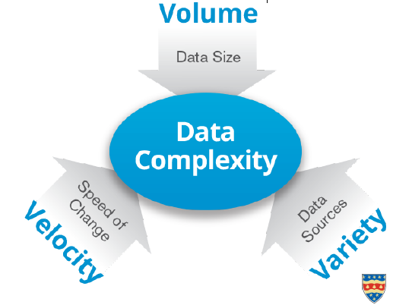
Big Data

Slide 5
Big Data
“Big data refers to DATASETS who’s size is BEYOND the capacity of typical database software tools to capture, store, manage & analyse”
– John Morton (Chief Technology Officer, SAS UK)
Assumes that as technology advances
- size of datasets that qualify as big data will also increase
Tweets data are growing so rapidly that we are not going to be able to manage that collection – even though each tweet is small

Slide 6
Medical imagery
On average a medical image file is 35 megabyte
- about 30 files make one gigabyte of information
How many of these files in a hospital?
collection big data…

Slide 7
80% of the world’s data IS UNSTRUCTURED (text, voice, images, video, etc)
In one minute 72 hours of new multimedia material is uploaded to YouTube
In one minute more than 200,000 Instagram posts
In one more than 200 million emails are exchanged in the world
No longer manage to store & process the information
Technology allows us to analyse the data while it is being generated (known as in-memory analytics).

Slide 8
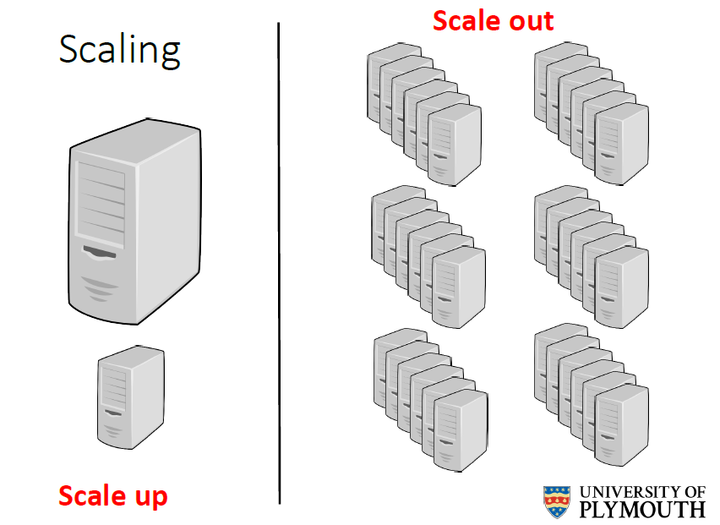

Slide 9
New data storage systems

Slide 10
Emerging data models
Bigtable: Google Bigtable
Key-value store, or key-value database: Redis, MemcacheDB, Berkeley DB (BDB), HamsterDB...
Document-oriented database, or document store: MongoDB, CouchDB, OrientDB, RavenDB, Lotus Notes....
Graph database: Neo4j, HyperGraphDB...

Slide 11
NoSQL features
Non-relational – not table based
Cluster friendly
- meant to work in a distributed environment
- database not in one single place
- speed across a cluster
Open source - no customer support
- communities, like stack overflow
21st Century Web
- typically associated with web applications/Internet

Slide 12
Key-value store
Key-value pairs are similar to a table
key serves as an index to find an associated value
Key-value pairs are similar to accessing data in memory
the key is a memory location & the value is the data stored at the location, making key-value pairs a good data model for in-memory databases

Slide 13
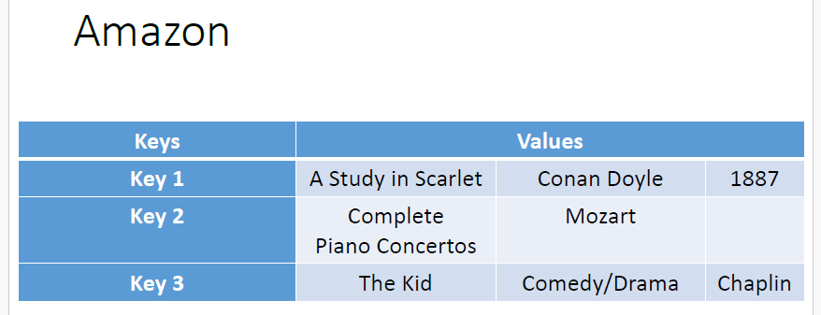

Slide 14
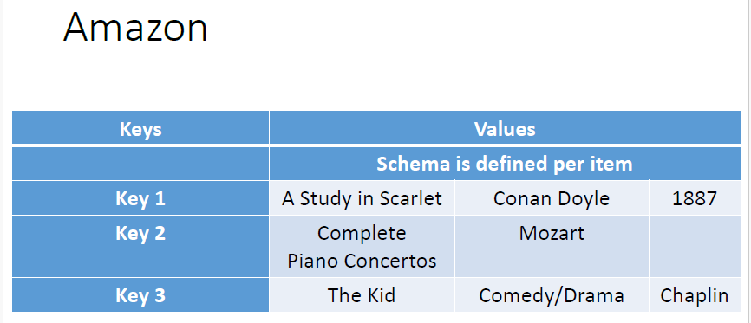

Slide 15
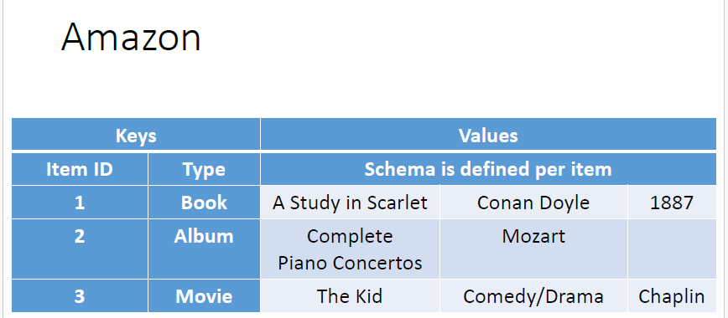

Slide 16
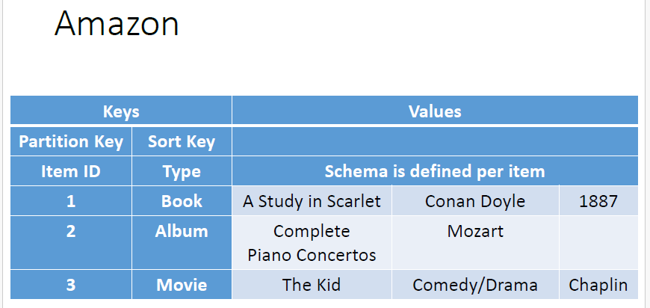

Slide 17
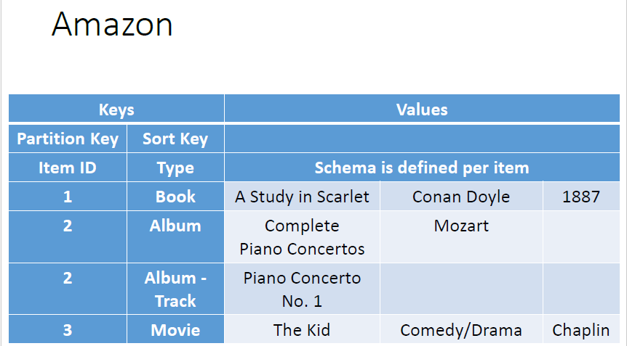

Slide 18
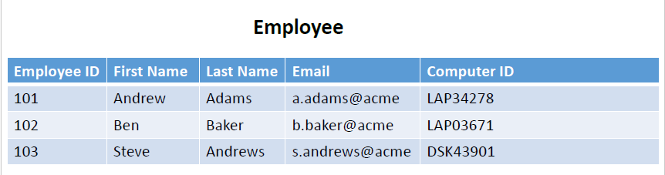
Relational Databases

Slide 19
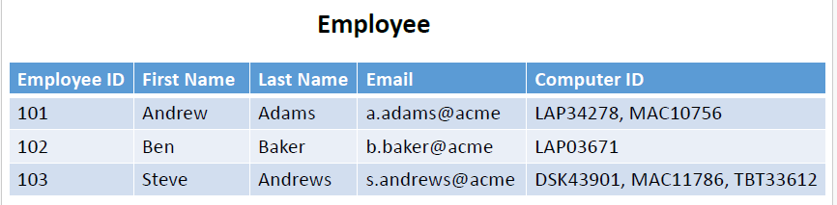
Relational Databases

Slide 20
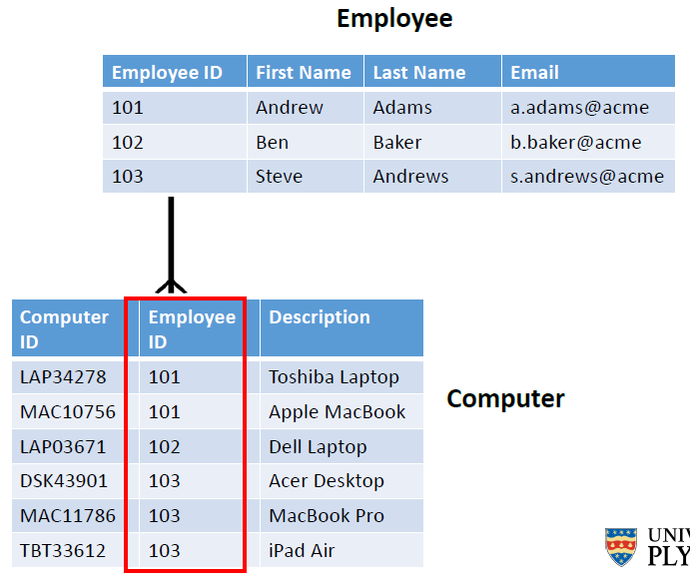
Relational Databases

Slide 21


Slide 22
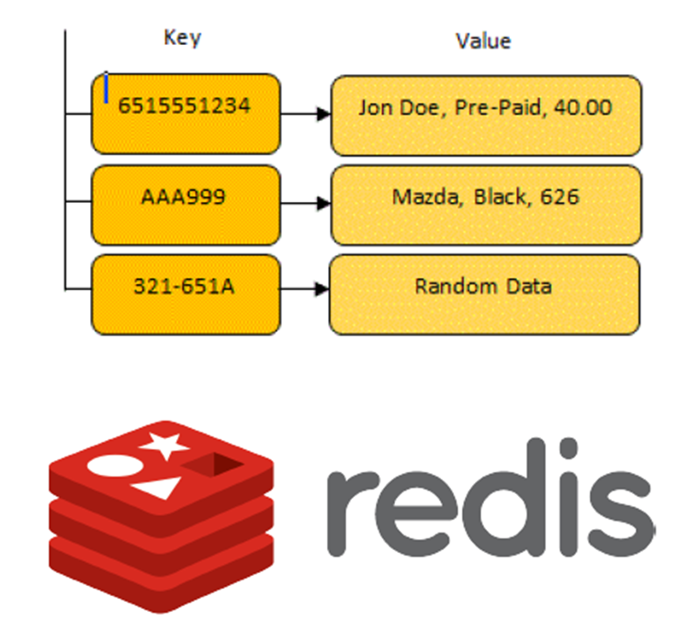
Key-value store: Features
Responsibility of the application to understand what the value stores
In some key-value stores, such as Redis, the value can store lists, sets, hashes…

Slide 23
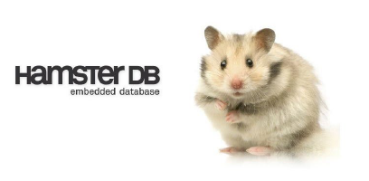
Examples of key-value stores
Redis
Memcache DB
Berkeley DB (BDB)
HamsterDB (especially suited for embedded devices)
Amazon DynamoDB (not open source)
Project Voldemort (open source implementation of Amazon DynamoDB)

Slide 24
When to use….
User profiles
Users have a unique ID & preferences, such as language, time zone, products the user has access to, etc
Can all be put into an object, so getting preferences of a user takes a single GET operation
Shopping carts
E-Commerce websites have shopping carts tied to the user.
- Shoppiing carts available all the time across browsers, machines, & sessions,
all the shopping information can be put into a single value
– the key is the user ID

Slide 25
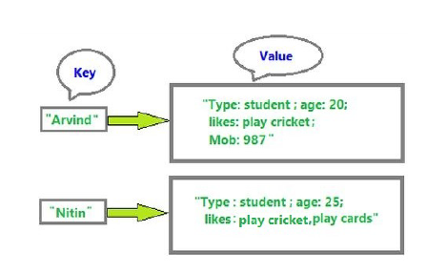
Not advisable to use when…
Typically, key-value stores can only be queried by the key
Not possible to query by some attribute of the value
Your application would need to read the values from the database to see if the attributes meet the conditions

Slide 26
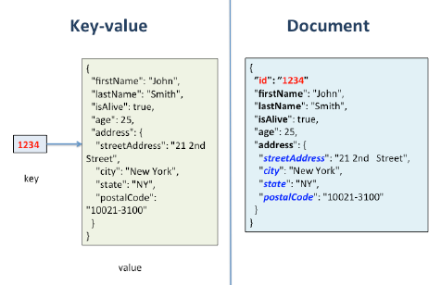
Document-oriented databases
all of the data associated with an individual record is encapsulated in what is referred to as a document
Essentially, it is like a key-value store, except that the value is a document
Internal structure in the document in order to extract metadata
every stored object can be different from every other, with optional fields
Usually encoded in some form of standard format such as XMLor JSON

Slide 27
Features
Each document can share a common structure but can also vary in the types of fields that they contain. This approach allows new information to be added to some documents without requiring that all documents have the same structure

Slide 28
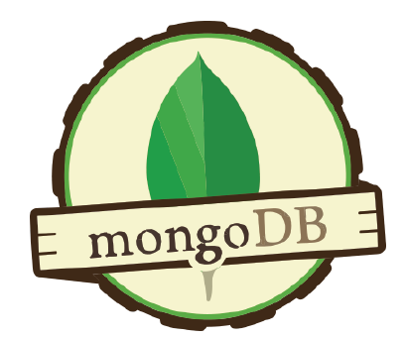
Examples of document databases
MongoDB
CouchDB
Terrastore
OrientDB
RavenDB
Lotus Notes

Slide 29
Useful for event logging
Servers generate a large number of events that contain useful information about their operation, including errors, warnings & user behaviour
Most servers, store log data in plain text files. Although plain-text logs are accessible & human-readable, they are difficult to use, reference & analyse without other systems for aggregating & storing this data
Document databases can store all these different types of events & can act as a central data store for event storage. This is especially true when the type of data being captured by the events keeps changing

Slide 30
Useful for content management systems
Websites mostly comprised static text: Brochureware.
an array of text, audio, video, images and social media is needed to get users’ attention
New attributes cannot be easily added to a relational database – not without impacting performance or taking the database offline
Since document databases have no predefined schemas and usually understand JSON documents, they work well in content management systems or applications for publishing websites, managing user comments, user registrations, profiles, etc...

Slide 31
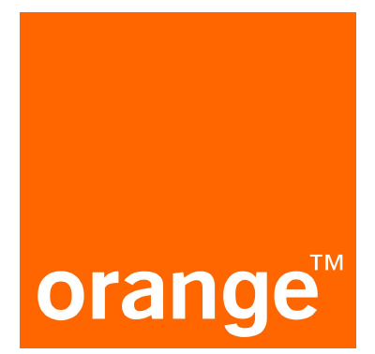
Example
Orange Digital, a subsidiary of France Telecom, maintains the websites Orange(www.orange.co.uk), Orange World, & the Orange Business site, as well as a number of EE’s digital assets.
No longer hosting the data & has moved to Amazon's cloud-based web service
Orange Digital decided to use MongoDB to store content and metadata
“Moving to MongoDB has required a mindset shift... you have to think about how data is used, rather than how it's stored,”
Phil Butterworth –Principal Database Engineer

Slide 32
Disadvantages
Queries against a varying structure

Slide 33
Column-family databases
Column oriented databases build on the concepts introduced by Google's BigTableapproach to provide a flexible way of managing data with variable structure.
Column-oriented databases provide a way to group columns into column families and to dynamically add new columns as needed to a column family.
Column families are groups of related data that is often accessed together

Slide 34
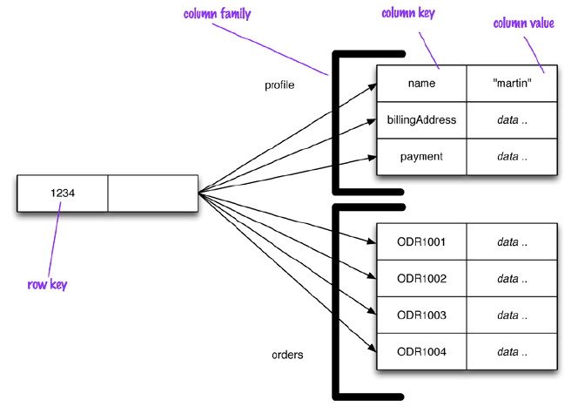

Slide 35
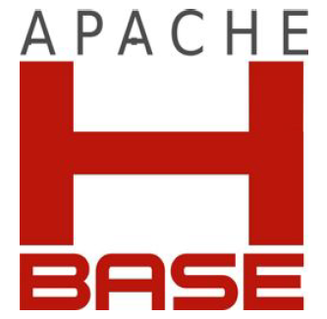
Examples
Cassandra
HBase
Hypertable
Amazon SimpleDB
Amazon DynamoDB

Slide 36
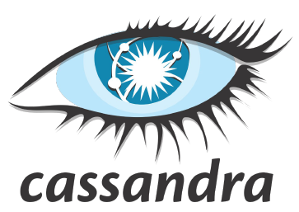
Useful when: Expiring usage
Expiring columns: Some databases, such as Cassandra, allows you to have columns which are deleted automatically after a given time. This time is known as TTL (Time to Live). The column is deleted after the TTL has elapsed.
Examples: Expiring columns can be very useful for applications providing demo access to users, or applications displaying ads on a website for a specific time. When the TTL has elapsed and the column does not exist anymore, the access can be revoked or the banner can be removed

Slide 37
Useful for: content management systems
Using column families, we can store blog entries with tags, categories and links in different columns.
Blog users and the actual blogs can be put into different column families

Slide 38
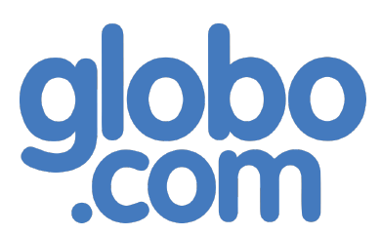
Example
Cassandra was developed at Facebook to power the Facebook inbox search feature
Facebook released Cassandra as an open-source project on Google code in July 2008.
Currently, Globo.com’s live streaming platform is implemented using Cassandra. Globo.com is the Internet branch for GrupoGlobo, one of the 5 largest media conglomerates in the world, producing content such as TV series, TV shows, news shows, etc. exporting them worldwide

Slide 39
Not advisable to use when...
If you need to aggregate data using queries involving operations such as SUM or AVG, you will have to do this on the client side, using the data retrieved by the client from the database.
Column-oriented databases are not great for prototyping: during the early stages, you may not be sure about how the query patterns will change, and as these change, you have to modify the column family design

Slide 40

Any Questions?

